Slide 1
MySQL Cursors

Slide 2
Introduction
MySQL Cursors are supported inside stored programs. Whenever a client get a connection with the server, by default Oracle server provides an implicit work area to each client for its internal processing of MySQL statements.
This work area is dedicated to a specific client. This implicit work area is called as implicit cursor. A client can access the implicit cursor with the name MySQL.

Slide 3
Introduction
MySQL Cursors are used for rows repetition returned by a query on a row-by-row process.
SQL commands will function on all the rows at one time in the program.

Slide 4
Introduction
Cursors can be created inside the Triggers, Functions and Stored Procedures.
MySQL Cursors contain 3-properties:
Asensitive
Read only
One directional

Slide 5
Feature
MySQL cursor moves only in one direction. Data fetching can be done in only one direction, and cannot fetch data in opposite direction.

Slide 6
Syntax of Cursors
Declare <cursor_name>cursor for<select statement>
open <cursor_name>;
fetch<cursor_name>into<variable1>,<variable2>;
close<cursor_name>;
cursor_name => The name assigned to a cursor.
variables => variables are the column values.

Slide 7
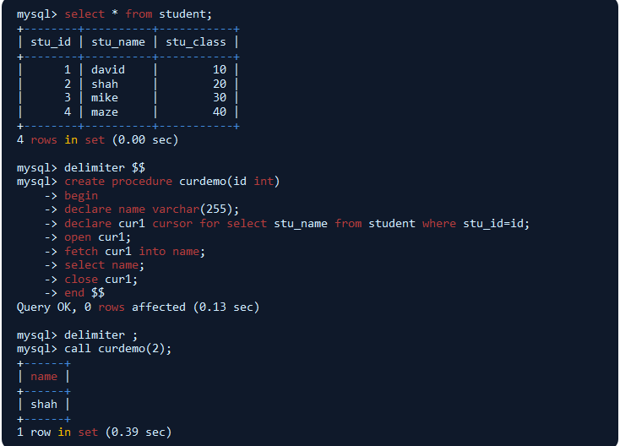

Slide 8
Example
In the above example, curdemo is a input parameter which accept input values. cur1 is the attribute used in the cursor. open() is used to open the cursor, fetch is used to fetch the row values into names and close cursor will remove the open cursor for same minutes. Then the call cursor will execute the curdemo and return the records(i.e, call cursor will call the stu_id(2) and it will return the name(shah)).

Slide 9
Steps for writing the cursor
Declare – Is a variable length value.
Open – Opens a cursor variable that is associate with a query.
Fetch – Retrieve a specific row and columns.
Empty – Which contain an empty set.
Close – Closing of a cursor.

Slide 10
Steps for writing the cursor
Declare <cursor_name>cursor for<select statement>
open <cursor_name>;
fetch<cursor_name>into<variable1>,<variable2>;
close<cursor_name>;
Cursor_name => The name assigned to a cursor.
variables => variables are the column values.

Slide 11
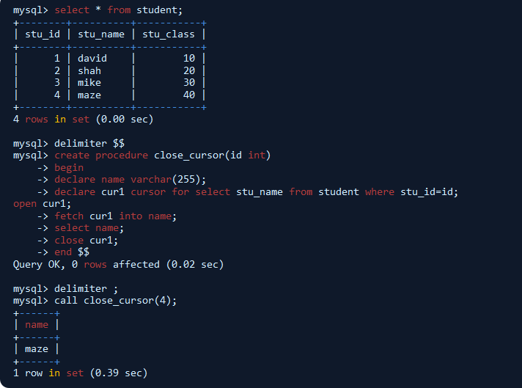

Slide 12
Example
In the above example, close_cursor is a input parameter which accept input values. cur1 is the attribute used in the cursor. open() is used to open the cursor, fetch is used to fetch the record values from cursor, select name will return the name of the record and close cursor is used to close the cur1. Then the call cursor will execute the cur1 and return the records(i.e, call cursor will call the stu_id(4) and it will return the name(maze)).

Slide 13
Thank You

